Slide 1
Key Applications of the IoT/M2M 物聯網重要應用
國立交通大學資訊工程系
Department of Computer Science
National Chiao Tung University
November 29, 2016

Slide 2
Outline
Industrial IoT/M2M
Industrial Automation
eHealth
Smart Grid
Consumer IoT/M2M
Smart Home
Smart Cities
Connected Car
Notes:
大綱
‧e 醫療
‧智能電網
‧智能居家
‧車連網

Slide 3
Industrial Automation
Notes:
e 醫療

Slide 4
Outline
Service-oriented architecture(SOA)-based device integration
SOCRADES: Realizing the enterprise integrated web of things
IMC-AESOP: from the web of things to the cloud of things
Conclusion
Notes:
大綱
‧Service-oriented architecture(SOA)-based device integration
‧SOCRADES:實現企業集成的物聯網
‧IMC-AESOP:從物聯網到雲端物聯網
‧總結

Slide 5
Service-Oriented Architecture
A service-oriented architecture (SOA) is an architectural pattern in computer software design in which application components provide services to other components via a service bus. (typically over a network)
The principles of service-orientation are independent of any vendor, product or technology.
A service is a self-contained unit of functionality, such as retrieving an online bank statement. By that definition, a service is a discretely invokable operation.
Notes:
service-oriented architecture (SOA)服務導向架構是軟體設計中的一種架構模式，其中應用元件通過service bus(通常為網路)象棋他元件提供服務。
服務導向的原則獨立於任何供應商，產品或技術
服務是一個獨立的功能單元，例如檢索網路銀行狀態。 通過該定義，服務是離散可調用的操作

Slide 6
Service-Oriented Architecture
SOA can act as a unifying technology that spans several layers.
direct device interaction
a wide range of interactions in a cross-layer way with a variety of heterogeneous devices
Notes:
服務導向架構可以做為跨越若干層的統一技術
-設備直接互動
-在跨層方式與各種異構設備下廣泛的相互作用

Slide 7
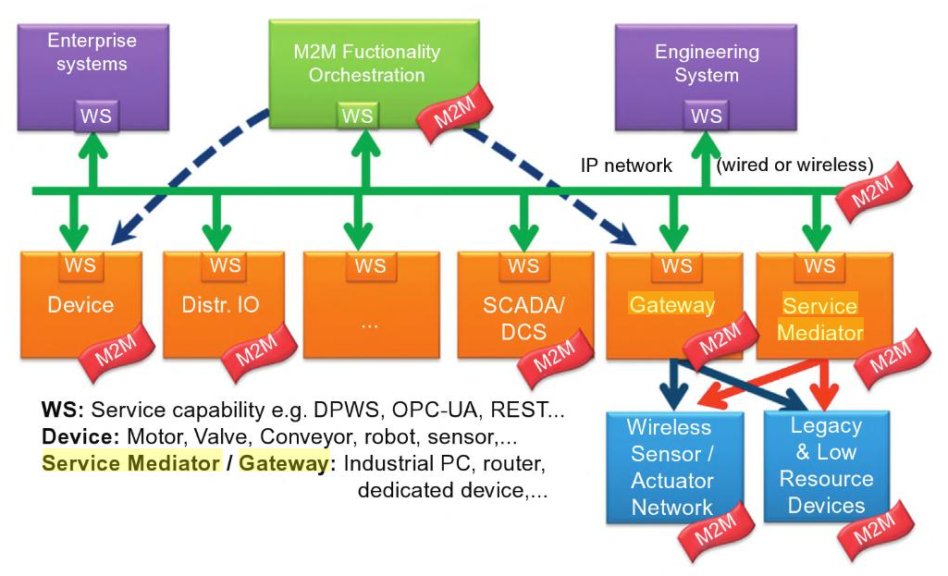
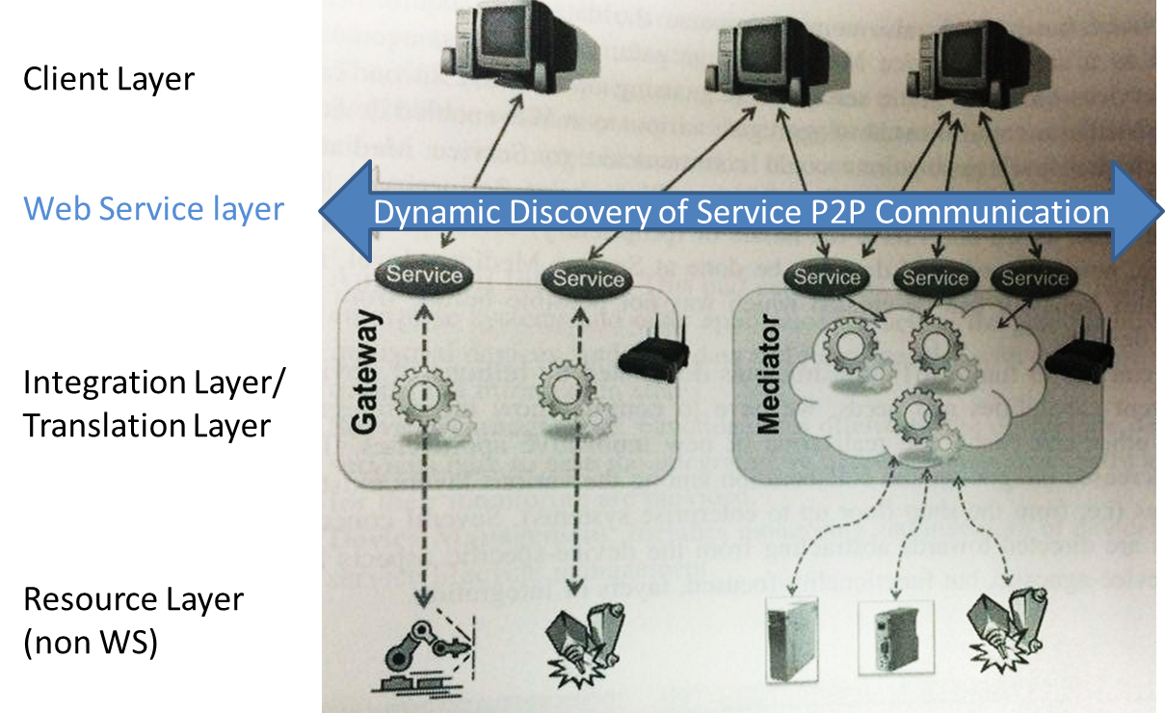
M2M SOA-based integration
DPWS: Devices Profile for Web Services
OPC-UA: Open Platform Communications – Unified Architecture
REST: Representational State Transfer based on a stateless,
client-server, cacheable communications protocol
Source: Book by Jan Holler, Catherine H. Mulligan, Stamatis Karnouskos, Vlasios Tsiatsis, David Boyle, Stefan Avesand, “From Machine-to-Machine to the Internet of Things: Introduction to a New Age of Intelligence” .
Notes:
Devices Profile for Web Services (DPWS)
Open Platform Communications(OPC-UA) Unified Architecture is an industrial M2M communication protocol for interoperability developed by the OPC Foundation
SCADA (supervisory control and data acquisition) is a system that operates with coded signals over communication channels so as to provide control of remote equipment
Distributed control systems (DCS) are used in industrial and civil engineering applications to monitor and control distributed equipment with remote human intervention.
Services can be combined to provide the functionality of a large software application. SOA makes it easier for software components on computers connected over a network to cooperate. Every computer can run any number of services, and each service is built in a way that ensures that the service can exchange information with any other service in the network without human interaction and without the need to make changes to the underlying program itself.
開放平台通信（OPC-UA）統一架構是由OPC基金會開發的工業M2M通信協議，並用於互操作性
SCADA（監控和數據採集）是通過通信信道使用編碼信號進行操作的系統，以便提供對遠程設備的控制分佈式控制系統（DCS）用於工業和土木工程應用中，以通過遠程人工干預來監視和控制分佈式設備。
服務可以組合以提供大型軟體應用程序的功能。 SOA使通過網絡連接的電腦軟體元件更容易合作。 每台電腦可以運行任何數量的服務，並且每個服務以確保該服務可以與網絡中的任何其他服務交換信息的方式建立，而無需人為交互，並且不需要對底層程序本身進行改變。

Slide 8
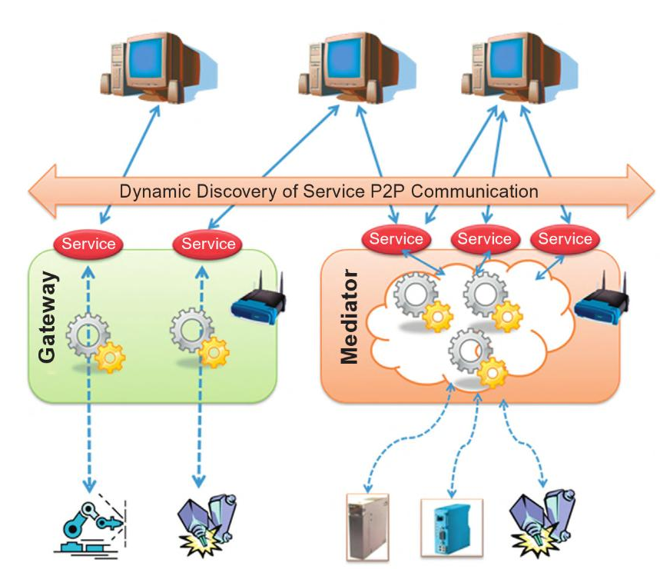
Non-service-enabled Device Integration
Source: Book by Jan Holler, Catherine H. Mulligan, Stamatis Karnouskos, Vlasios Tsiatsis, David Boyle, Stefan Avesand, “From Machine-to-Machine to the Internet of Things: Introduction to a New Age of Intelligence” .
Notes:
非符合SOA的設備整合必須要使用 Gateway或 Mediator，透過Gateway或 Mediator這些設備才能夠以Web Service的介面來和系統整合

Slide 9
Gateway
A device controls a set of lower-level non-service-enabled devices.
Replacing limited-resource devices or legacy devices by natively WS-enabled devices without impacting the applications using these devices.
non-service-enabled devices
gateway
service-enabled devices
- - - - - - - - - - - - - - - - - -
Notes:
Gateway
-控制一組較低級別的non-service-enabled設備
-由natively WS-enabled設備替換有限資源設備或傳統設備，而不影響使用這些設備的應用程序。

Slide 10
SOCRADES (Service Oriented Cross-layer infRAstructure for Distributed smart Embedded deviceS)
The SOCRADES project (2006-2009) is a European research and advanced development project.
Its primary objective is to develop a design, execution and management platform for next-generation industrial automation systems, exploiting the Service Oriented Architecture paradigm both at the device and at the application level.
PLATFORM
Design
Execution
management
device
application
Notes:
SOCRADES項目（2006-2009）是一個歐洲研究和先進的開發項目。
其主要目標是為下一代工業自動化系統開發設計，執行和管理平台，在設備和應用程序層面開發服務導向的架構範例。

Slide 11
New Challenges: why SOCRADES?
Rely on a large ecosystem of systems where collaboration at large scale will take place.
Mashing up services have proven to be a key advantage in the Internet application area.
If devices can either host web services natively or be represented as such in higher system, existing tools and approaches can be used to create mash-up apps that depend on these devices.
Notes:
新議題
-依靠一個龐大的系統生態的系統，大規模的合作將發生
-Mashing up services已被證明是互聯網應用領域的關鍵優勢
-如果設備可以在本地端主管web服務，或是被表現於較高階的系統裡，就可以用現有的工具和方法去創建基於這些設備的mash-up應用。

Slide 12
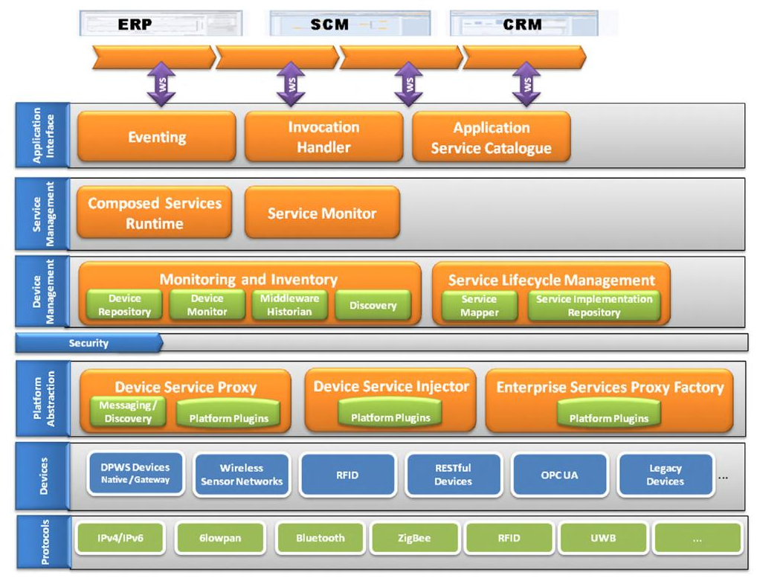
SOCRADES Integration Architecture (SIA)
ERP – Enterprise Resource Planning
SCM – Supply Chain Management
CRM – Customer Relation Management
Source: Book by Jan Holler, Catherine H. Mulligan, Stamatis Karnouskos, Vlasios Tsiatsis, David Boyle, Stefan Avesand, “From Machine-to-Machine to the Internet of Things: Introduction to a New Age of Intelligence”.
Notes:
SIA係用階層式的架構來支援三種主要服務功能:
ERP - 企業資源規劃
SCM - 供應鏈管理
CRM - 客戶關係管理
階層式的架構從底層到上層分別是
通訊協定層
裝置層
平台抽象層
安全層
裝置管理層
服務管理層
應用介面層

Slide 13
SOCRADES Integration Architecture(SIA)
Application Interface :
Enables the interaction with traditional enterprise systems and other applications.
It acts as the glue for integrating the industrial devices, and their data and
functionalities with enterprise repository and traditional information stores.
Notes:
應用介面:
實現與傳統企業系統和其他應用程序的互動
它作為集成工業設備及其數據和功能與企業知識庫和傳統信息存儲的粘合劑。

Slide 14
SOCRADES Integration Architecture(SIA)
Service Management :
In order to ease the integration in traditional enterprise landscapes.
Notes:
服務管理
以便於在傳統企業中的整合

Slide 15
SOCRADES Integration Architecture(SIA)
Device Management :
Includes monitoring and inventory of devices.
Notes:
裝置管理
包括設備的監控和清單。

Slide 16
SOCRADES Integration Architecture(SIA)
Platform Abstraction :
Enables the abstraction of all devices independent of
whether they natively support WS or not,
to be wrapped and represented as services on the higher systems.
This layer also provides a unified view on remotely installing or updating the
software that runs on devices
Notes:
平台抽象化
-使得能夠獨立於他們原生地支持WS的所有設備的抽象，被包裝和表示為較高系統上的服務。
-此層還提供了在設備上運行遠程安裝或更新軟體的統一視圖

Slide 17
SOCRADES Integration Architecture(SIA)
Devices & Protocols :
Include the actual devices that connect over multiple protocols
to the infrastructure.
The respective plugins need to be in place so that
they can be seamlessly integrated to SIA.
Notes:
裝置和協議
-包括通過多種協議連接到基礎設施的實際設備
-相應的套件需要到位，以便它們可以無縫集成到SIA。

Slide 18
Local Discovery Unit(LDU)
To realize discovery and interaction in a P2P way, a local gateway/service-mediator is implemented.
LDU would enable the dynamic discovery of devices on premise and their coupling with the SIA.
SIA has been used in several scenarios as a proof of concept for the integration among different devices, both locally and with enterprise systems.
Example: passive energy monitoring via the usage of sensors and gateways.
Notes:
本地發現單元(LDU)
為了實現P2P方式的發現和交互，實現了本地gateway/服務中介器。
LDU將啟用對內部設備的動態發現及其與SIA的耦合。
SIA已被用於幾種場景，作為本地和企業系統中不同設備之間集成的概念證明。
範例：通過使用感測器和gateway進行被動能源監控。

Slide 19
IMC-AESOP Intelligent Monitoring & Control - ArchitEcture for Service Oriented Process monitoring & control
The IMC-AESOP project is a European research and development project and is a part of the Collaborative Project initiative of the European Union's 7th Framework Programme from Sep. 2010 to Dec. 2013.
The project goes beyond WS-enabled devices towards the cloud in order to harness its benefits, such as resource flexibility, scalability.
The result is a highly dynamic flat information-driven infrastructure that will empower the rapid development of better and more efficient next generation industrial applications, while in parallel satisfying the agility required by modern enterprises.
IMC-AESOP primarily realizes a SoA-based approach for next generation of SCADA (Supervisory Control And Data Acquisition)/DCS (Distributed Control System) systems targeting Process Control Applications.
Notes:
IMC-AESOP
-IMC-AESOP項目是一個歐洲研究和開發項目，是2010年9月至2013年12月歐盟第七個框架計劃的合作項目計劃的一部分。
-該項目超越了支持WS的裝置並走向雲端，以利用其優勢，如資源靈活性，可擴展性。
-成果是一個高度動態的平面信息驅動的基礎設施，將能夠快速發展更好和更有效的下一代工業應用，同時滿足現代企業所需的敏捷性。
-IMC-AESOP主要實現基於SoA的下一代SCADA（監控和數據採集）/ DCS（分佈式控制系統）系統，用於過程控制應用。

Slide 20
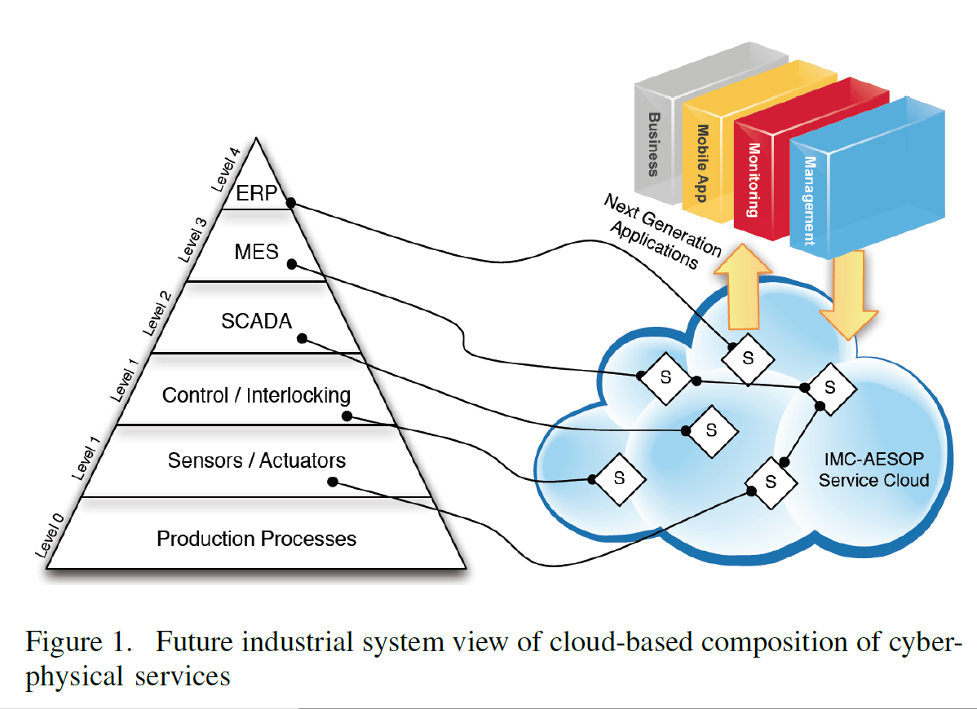
IMC-AESOP
MES - Manufacturing Execution Systems
ERP - Enterprise Resource Planning system
SCADA - Supervisory Control And Data Acquisition
Source: Book by Jan Holler, Catherine H. Mulligan, Stamatis Karnouskos, Vlasios Tsiatsis, David Boyle, Stefan Avesand, “From Machine-to-Machine to the Internet of Things: Introduction to a New Age of Intelligence” .
Notes:
MES - 製造執行系統
ERP - 企業資源規劃系統
SCADA - 監控和數據採集

Slide 21
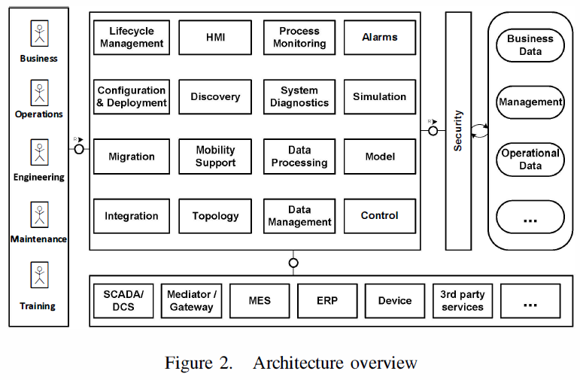
IMC-AESOP
Source: Book by Jan Holler, Catherine H. Mulligan, Stamatis Karnouskos, Vlasios Tsiatsis, David Boyle, Stefan Avesand, “From Machine-to-Machine to the Internet of Things: Introduction to a New Age of Intelligence” .
Notes:
IMC-AESOP架構圖

Slide 22
Challenges
Outsourcing key functionalities to the cloud.
Further research needs to be done towards the applicability of it for several scenarios.
monitoring
real-time interactions, reliability
Safety, maintainability, and security.
Notes:
挑戰
-將關鍵功能外包給雲端。
-需要進一步研究它在幾種情況下的適用性。
-監控
-即時互動，可信度
-安全(Safety)，可維護性和安全性(security)

Slide 23
Conclusion
Service-oriented approaches are now possible at device level, and bring with them benefits previously only available to the designers and managers of enterprise systems.
Although several challenges are open, the latest visions describe a fully dynamically customizable infrastructure that harnesses the best breed of functionalities at device and at cloud level in order to empower the next generation of applications and services.
Notes:
總結
-服務導向的方法在現今的設備層面是可能的，並且帶來了過往僅對企業系統的設計者和管理者的好處
-雖然出現了幾個新的議題，最新的願景描述了一個完全動態可客制的基礎設施，利用設備和雲層次的最佳品種的功能，以授權下一代應用程序和服務。

Slide 24
References
From “Machine-to-Machine to the Internet of Things: Introduction to a New Age of Intelligence”, Chapter 11.
Difference between DCS and SCADA http://control.com/thread/1365080091
OPC-UA http://matrikonopc.cn/opc-ua/
SCADA https://en.wikipedia.org/wiki/SCADA
IMC-AESOP Project http://www.imc-aesop.org/index.html
http://www.hs-emden-leer.de/forschung-transfer/projekte/imc-aesop-project.html

Slide 25
eHealth
Notes:
e 醫療

Slide 26
Outline
R&D Projects at CGU (Chang-Gung University)
The intelligent elderly care equipment R & D projects
Home Gateway and Community Platform for the Elderly
Notes:
長庚大學-智慧型高齡者照護用臨床醫材研發計畫
高齡生活居家閘道與社區平台
長庚大學-銀髮族退化偵測與健康促進
健康促進與照護平台

Slide 27
1. The intelligent Elderly Care Equipment R & D Projects
Wearable medical equipment
Function-Strengthened “Action Care“ Medical Equipment
Clinical Interaction Module and System
Notes:
長庚大學-智慧型高齡者照護用臨床醫材研發計畫
穿戴型隨身照護資材
機能強化行動照護醫材研發
臨床互動Dr.e高齡者照護用醫材臨床試驗與功能測試
產業融整推動辦公室
協同研發專案管理

Slide 28
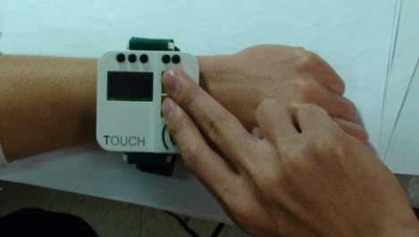
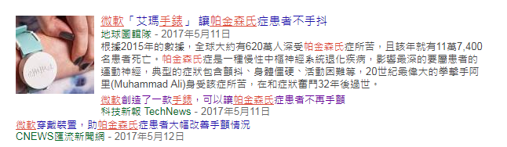
Wearable Medical Equipment
Wearable watch
Life sensing and watches
Function: time, weather conditions, and medication remind mechanism
Wearable physiological monitoring device
Real-time, continuous
Future applications: hyperactive children, Parkinson's disease, epilepsy
Notes:
隨身照護醫材
隨身照護腕錶
生命感測與手錶結合
功能：時間、用藥、天氣狀況的提醒機制
隨身生理監測裝置
即時、連續
未來應用：過動兒、巴金森症、癲癇

Slide 29
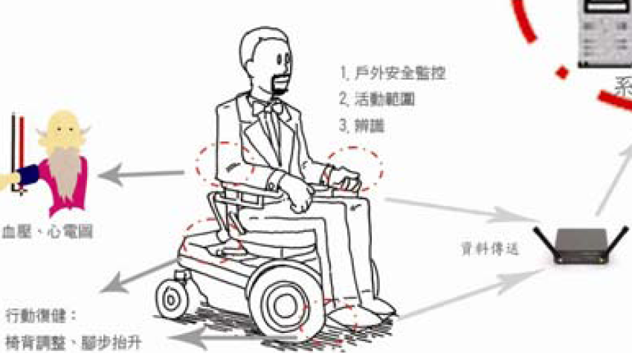
Function-Strengthened “Action Care“ Medical Equipment
Intelligent human factor auxiliary semi-automatic wheelchair cum foot rehabilitation board
Power assistance for personal fitness and function strengthening for rehabilitation needs
Real-time remote network monitoring navigation
The lightweight pedals can do multi-angle movement for
foot rehabilitation.
Notes:
機能強化行動照護醫材
智慧型人因輔助半自動輪椅暨腳踏復健板
個人健身動力輔助、強化復健需求機能
遠端網路即時監控導航
輕巧腳踏板，可做多角度運動，進行腳步復健

Slide 30
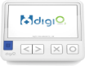


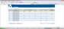
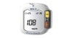




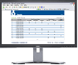

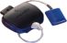
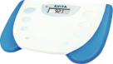

Clinical Interaction Module and System
Medicine Reminder
Message Notification
Web-Based Remote Monitoring
Data Center
Homecare gateway
Dr.e portable electronic physician
Chronic disease emergency advisory system
Blood pressure monitor communications assistant
Metabolic syndrome health management system
Provide healthcare self-management module (different diagnostic paths and physical conditions)
Provide automatic classification of health education and personalized diet and exercise recommendations
Enable self-care at home
Devices
代謝症候群
Notes:
臨床互動模組與系統
Dr.e隨身電子醫師
提供慢性疾病緊急狀況諮詢系統
血壓監控通報小幫手
代謝症候群健康管理系統
提供自我健康管理模組（不同診斷路徑與身體狀況）
提供自動分級衛教及個人化飲食運動建議
在家就能自主管理健康

Slide 31
2. Home Gateway and Community Platform for the Elderly
Goal: to provide basic necessities, recreation, interactive entertainment platform and security care
Achievement:
Implementation and application of home personal gateway
Medication reminders and drug identification
Smart Entertainment Platform
Design of indoor positioning and navigation system
Fall detection system
Cloud-Based Health Promotion and Care Platform
Notes:
高齡生活居家閘道與社區平台
目標: 提供衣食住行育樂、互動式娛樂平台與安全看顧
成果
居家個人閘道實作與應用
用藥提醒與藥品辨識
室內定位設計與導航系統
跌倒偵測系統
緊急救援自動派遣
智慧型互動桌

Slide 32
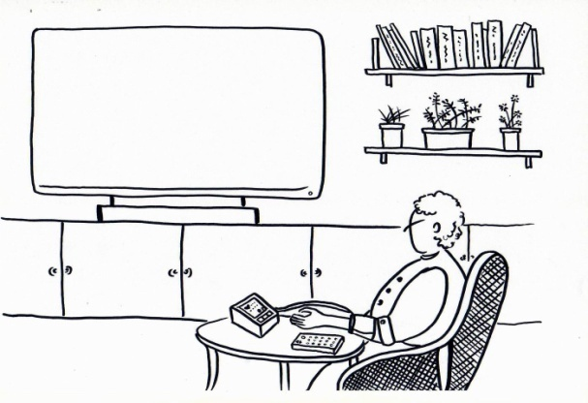
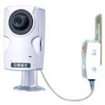
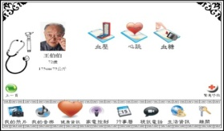
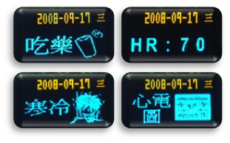
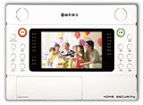
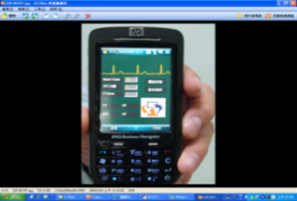
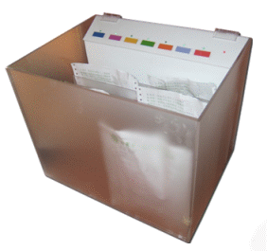
Home and Community Platform System Architecture
Home- & health-care gateway
Video fall detector
Event reminder
Security system
ECG-care watch
RFID medication management
Telemedicine service
Smart phone
Emergency call
Physical activity
Notes:
居家閘道與社區平台系統架構圖

Slide 33
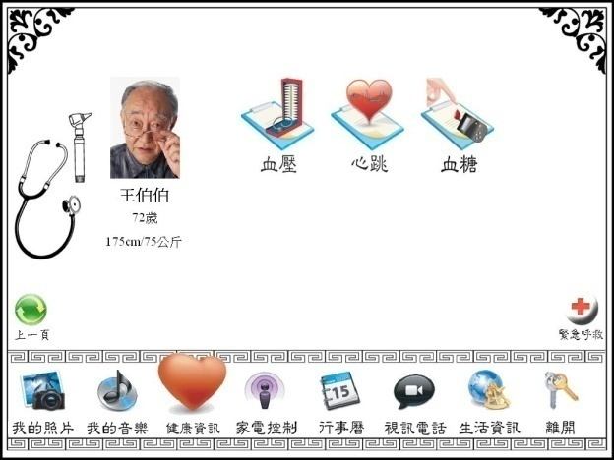


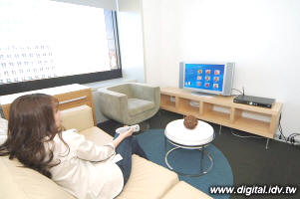
Home and Health-Care Gateway System Implementation and Application
Notes:
居家個人閘道實作與應用系統

Slide 34
Through a remote control, you can use the services in the living room or in any corner of your home.
The concept of a digital home is to
protect the quality of life for the elderly,
improve health
care for the elderly,
and finally to bring
much convenience
to the elderly.
Family Doctor
End User
Wireless Meter
For Physiology
Home Gateway
Report
Notes:
透過一支遙控器，可在全家大小在客廳或家中各個角落使用。
以數位家庭的概念為中心，針對老人生活品質的改善、老人健康照護的保障為主要目的，其次將展現數位家庭帶給生活上的許多便利的應用。

Slide 35
Drug Identification and Medication Reminders
Control of chronic diseases normally is done by long-term medication.
However, the memory degradation of the elderly often causes the risk of taking the wrong drug.
Use sensing and network technology to develop a system that reminds the elderly to take medicine according to doctors’ prescription and also informs the elderly’s children remotely.
The purpose is to reduce the risk of taking the wrong medicine by those seniors who live alone and also help them to establish the good habit of taking medicine regularly.
Notes:
用藥提醒與藥品辨識設計目的
因控制慢性病而長期服藥，然而記憶退化以致服用錯誤藥物的風險，是老年人居家生活中所遭遇的問題。
透過感測與網路技術，開發一套能遵照醫師指定用藥時間，準時提醒年長者服藥，並透過網路將長輩用藥資訊提醒在外子女的系統。
目的為降低生活自主的年長者錯誤服藥的機會，並建立年長者正常用藥的習慣。

Slide 36
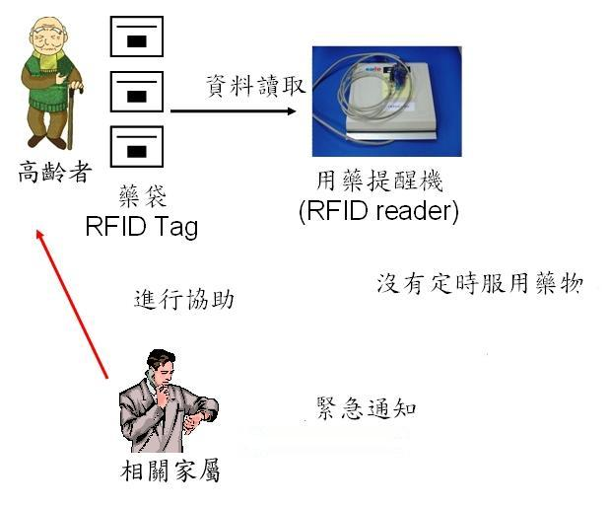
Drug Identification and Medication Reminders (Cont.)
The
Elderly
Medication Reminding
Machine
Detection of not taking
medicine - inform the
care giver urgently!
Care Giver
Notes:
用藥提醒與藥品辨識
為降低年長者錯誤服藥的機會，透過感測與網路技術，開發一套能遵照醫師指定用藥時間，準時提醒年長者服藥，並能透過網路將長輩用藥資訊提醒在外子女的系統。

Slide 37
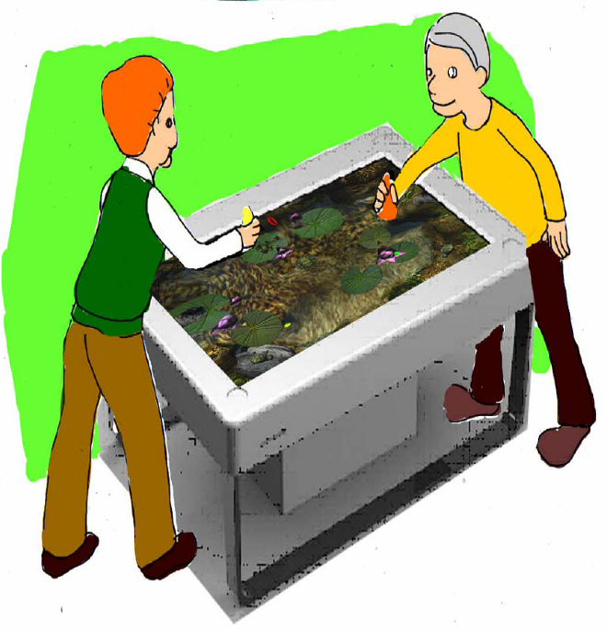
Smart Entertainment Platform Objective
Design based on the analysis of psychological and social needs of the elderly. Bring the convenience of digital technology into the elderly community to encourage interaction among residents, and improve the quality of their social life.
Notes:
智慧型娛樂平台系統開發目的
從高齡者生心理需求及社交行為模式的分析結果研發社區生活社交匣道，試著將數位科技的便利導入高齡社區，以鼓勵居民間互動，並提高社區更優質的社交生活。

Slide 38
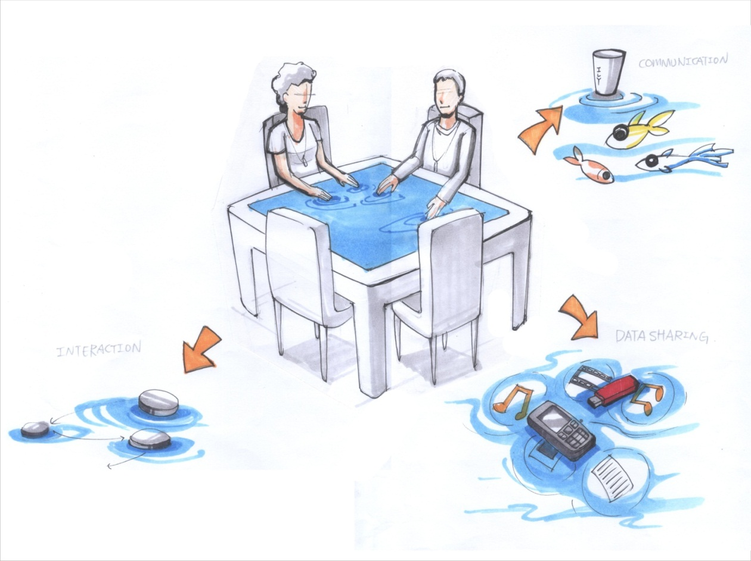
Smart Entertainment Platform ShareTouch
COMMUNICATION
INTERACTIVE GAMES
DATA SHARING
Sharetouch
Notes:
觸控式社區娛樂平台

Slide 39
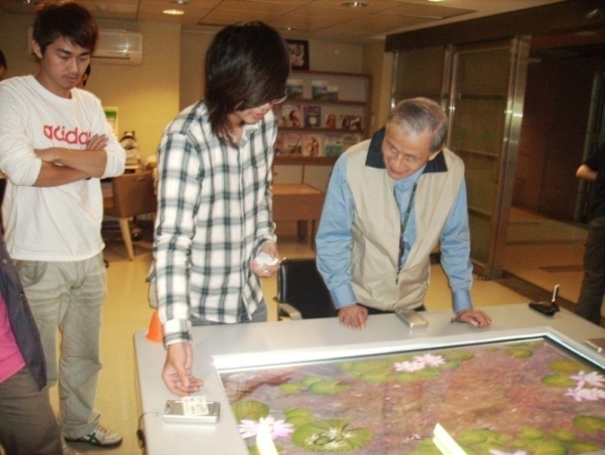
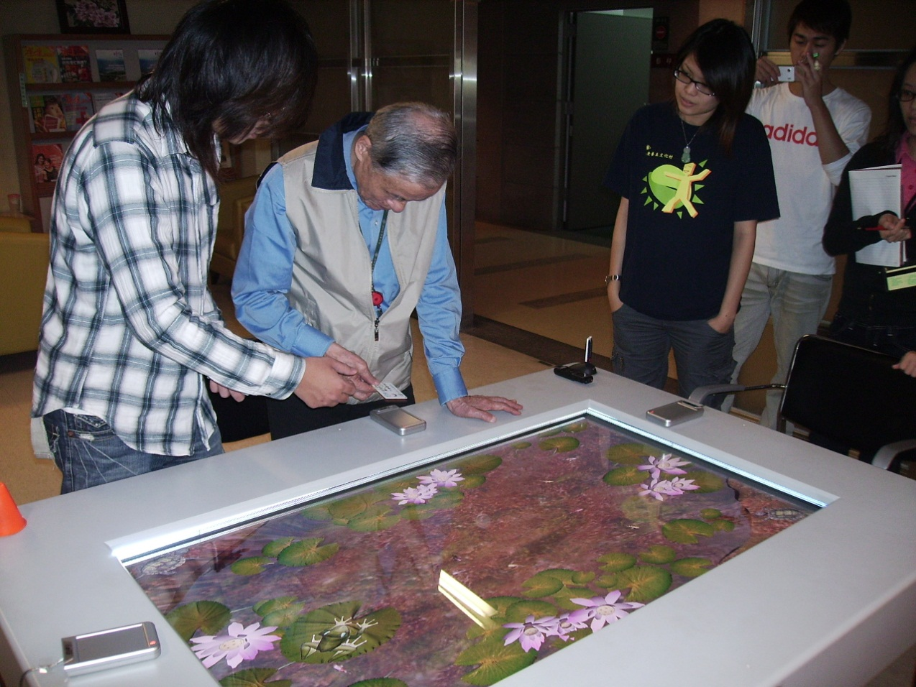
The Elderly log in to the system using RFID
Notes:
長者以RFID登錄系統

Slide 40
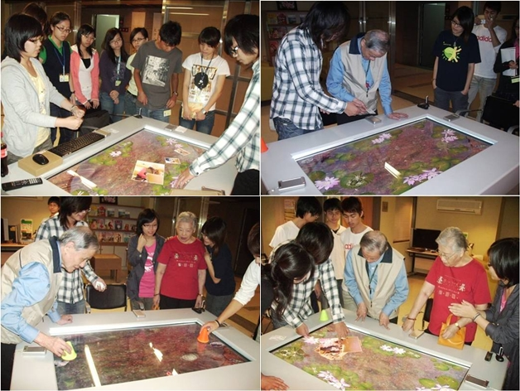
User Interactions
Notes:
使用者操作情況

Slide 41

Smart Entertainment Platform System Features
The intelligent digital table not only has the function of the table but also allow four people to interact via a large touch screen. It is very user friendly for the elderly and doesn’t need keyboard or mouse,
Notes:
智慧型娛樂平台系統特色
智慧型數位桌除了具有桌子的功能，並且提供四人同時觸控該大型觸控模組之大型觸控螢幕，以達到多個使用者及多點觸動之智慧型數位桌，其使用容易，也沒有鍵盤滑鼠，是相當具親和力之桌子。

Slide 42
Smart Grid

Slide 43
Outline
What’s Smart Grid?
Requirements and Architectural Goals of Smart Grid
NIST Architectural Models
ITU-T Architectural Models
Notes:
什麼是智能電網？
智能電網的需求和結構的目標
NIST結構模型
ITU-T結構模型
映射到ETSI M2M架構

Slide 44
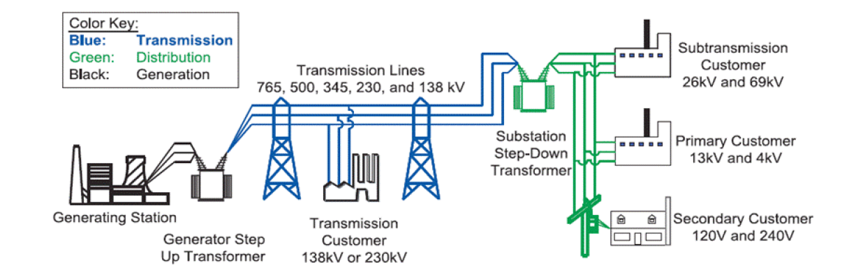
Legacy Electric Grid Architecture
發電
輸電
配電
Source: NIST Smart Grid Program Review
One-way flow of electricity
- Centralized, bulk generation, mainly coal and natural gas - Responsible for 40% of human-caused CO2 production - Controllable generation and predictable loads - Sized for infrequent peak demand – operates at 50% capacity - Limited automation and situational awareness - Lots of customized proprietary systems - Lack of customer-side data to manage and reduce energy use
Notes:
傳統的電力網路是 one-way flow，這樣的電力傳輸系統包過三個主要子系統發電，輸電及配電
傳統的電力網路之特性/限制：
集中，批量生成，主要是煤和天然氣
人類造成的CO2生產的40％
可控發電和可預測的負載
預算罕見的高峰需求 - 通常祗用50％的容量
有限自動化和情境意識
大量客制的專有系統
缺乏客戶端數據以管理和降低能源使用

Slide 45
Smart Grid = Electric Grid + Intelligence
The smart grid is a radical evolution of the energy supply and consumption infrastructure that will provide providers and consumers with unprecedented levels of reliability and control while reducing the adverse environmental impact of energy generation and consumption
A smart grid delivers electricity from suppliers to consumers using two-way technology to control appliances at consumers' homes to save energy, reduce cost and increase reliability and transparency.
Smart meters are part of a smart grid, but alone do not constitute a smart grid
Notes:
Smart grid的定義
智能電網是一個激進演進的能源供應和消費基礎設施，供應商和消費者提供了前所未有的可靠性和控制水平，同時降低能源生產和消費對環境的不良影響
智能電網提供電力從供應商到消費者，並使用雙向技術控制在消費者的家中的電器，以便節約能源，降低成本，提高可靠性和透明度。
智能電錶是智能電網的一部分，但本身並不構成一個智能電網

Slide 46
Smart Grid
Notes:
Smart grid概念圖

Slide 47
Requirements for Smart Grid
Utilities and their suppliers are integrating information technology and advanced communications into the power system in order to:
Increase system efficiency and cost effectiveness
Provide customers tools to manage energy use
Improve reliability, resiliency and power quality
Enable use of innovative technologies including renewables, storage and electric vehicles
Requirements:
Standardized architectural concepts, data models and protocols are essential to achieve interoperability, reliability, security and evolvability.
New measurement methods and models are needed to sense, control and optimize the grid’s new operational paradigm
Notes:
智能電網架構設計目標
智能電網架構設計之考量及需求點：（各點的說明，參考以下四張投影片）
可選性
互通性
可維護性
可升級
創新性
可擴展性
承繼性
安全
靈活性
可管理性
可負擔性

Slide 48
Architectural Goals for Smart Grid
Options – Architectures should support a broad range of technology options—both legacy and new. Architectures should be flexible enough to incorporate evolving technologies as well as to work with legacy applications and devices in a standard way, avoiding as much additional capital investment and/or customization as possible.
Interoperability – Architectures must support interfacing with other systems. This includes the integration of interoperable third-party products into the management and cyber-security infrastructures.
Maintainability – Architectures should support the ability of systems to be safely, securely, and reliably maintained throughout their life cycle.
Upgradeability – Architectures should support the ability of systems to be enhanced without difficulty and to remain operational during periods of partial system upgrades.
Notes:
可選性 - 結構支持範圍廣泛包括傳統和最新的的技術選擇 。結構應具有足夠的靈活性，包容不斷發展的技術與傳統的應用程序和設備，以標準的方式，盡可能避免額外的資本投資和/或客化需要。
互操作性 - 架構必須支持與其他系統接口的互操作性 。這包括可互操作的第三方產品的集成管理和網絡安全基礎設施。
可維護性 - 架構應該支持系統在其整個生命週期能被安全和可靠地維護。
可升級性 - 架構應該支持部分系統升級時，系統能被毫無困難地加強和保持正常運行。

Slide 49
Architectural Goals for Smart Grid (cont.)
Innovation – Architectures should enable and foster innovation. This includes the ability to accommodate innovation in regulations and policies; business processes and procedures; information processing; technical communications; and the integration of new and innovative energy systems.
Scalability – Architectures should include architectural elements that are appropriate for the applications that reside within them. The architectures must support development of massively scaled, well-managed, and secure systems with life spans appropriate for the type of system, which range from 5 to 30 years.
Legacy – Architectures should support legacy system integration and migration. (The key issue of dealing with legacy systems integration and migration is developed by SGAC Heterogeneity Working Party).
Notes:
創新性 - 架構促進創新。這包括適應法規和政策、業務流程和程序、信息處理、技術交流的創新能力，以及和創新的能源系統的整合。
可擴展性 - 架構應包括適當的架構元素以便應用程序駐留在其上。結構必須支持大型規模、管理完善的安全系統的發展，其生命周期適合該類型的系統，範圍可從5至30年。
承繼性 - 架構應該支持傳統的系統集成和遷移。 （處理遺留系統的集成和遷移的關鍵問題將由SGAC 異質性工作小組來開發）。

Slide 50
Architectural Goals for Smart Grid (cont.)
Security – Architectures should support the capability to resist unwanted intrusion, both physical and cyber. This support must satisfy all security requirements of the system components.
Flexibility – Architectures should allow an implementer to choose the type and order of implementation and to choose which parts of the architecture to implement without incurring penalties for selecting a different implementation.
Governance – Architectures should promote a well-managed system of systems that will be enabled through consistent policies over its continuing design and operation for its entire life cycle.
Affordability – Architectures should enable multivendor procurement of interoperable Smart Grid equipment through the development of mature national and international markets. Architecture should fundamentally enable capital savings as well as life cycle savings through standards-based operations and maintenance.
Notes:
安全性 - 架構應該抵制不必要的物理和網路的入侵。這種支持必須符合所有系統組件的安全要求。
靈活性 - 架構應該允許一個發展者去選擇任何類型和順序的實作並且不會因不同的選擇而遭罰。
可管理性 - 結構應促進良好的管理制度，系統將於整個生命週期使用一貫的政策，來繼續設計和運行。
可負擔性 - 通過成熟的國內和國際市場的發展，架構應使多廠商的可互操作的智能電網設備採購成為可能。通過基於標準的運營和維護，架構應該從根本上節省資本以及生命週期之費用。

Slide 51
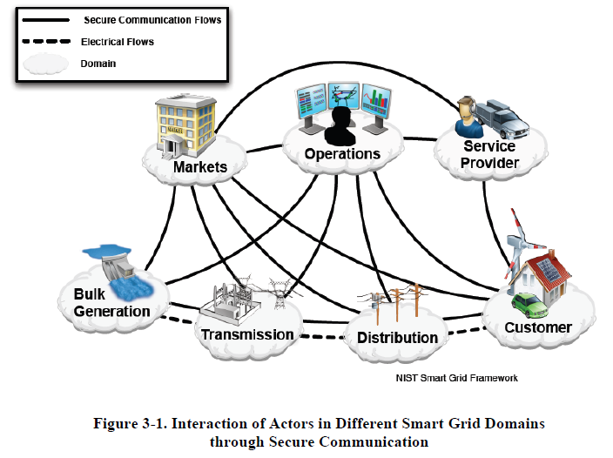
NIST Conceptual Reference Model
Source: NIST Framework and Roadmap for
Smart Grid Interoperability Standards,
Release 2.0
Notes:
Smart grid的概念：整體的系統環境包括七個子系統（亦即，七朵雲 Domain）
如前所述，傳統Power Grid 只有三個子系統（單向）。在smart grid的系統下，勢必將發展出其他的子系統（雙向）。
下一張投影片，說明每個子系統（小雲朵）的設計概念

Slide 52
Domains and Actors in the NIST Smart Grid Conceptual Model
 | Domain | Actors in the Domain
1 | Consumers | The end users of electricity. May also generate, store, and manage the use of energy. Traditionally, three customer types are discussed, each with its own domain: residential, commercial, and industrial
2 | Markets | The operators and participants in electricity market
3 | Service providers | The organizations providing services to electrical customers and to utilities
4 | Operations | The managers of the movement of electricity
5 | Bulk generation | The generators of electricity in bulk quantities. May also store energy for later distribution.
6 | Transmission | The carriers of bulk electricity over long distances. May also store and generate electricity.
7 | Distribution | The distributors of electricity to and from customers. May also store and generate electricity.
Notes:
NIST 智能電網的領域

Slide 53
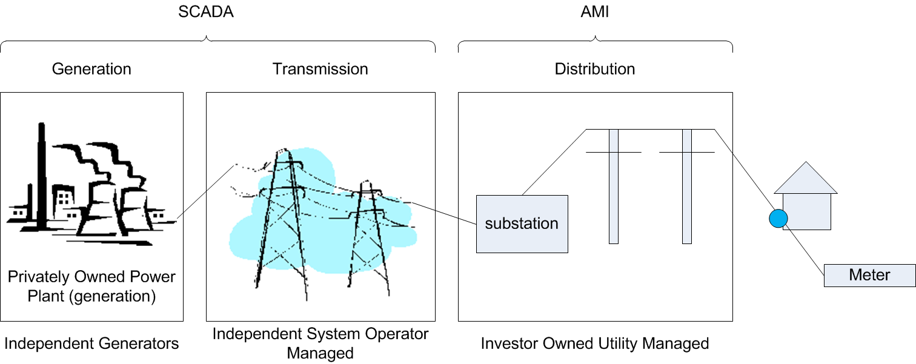
Smart Grid – A Simple Concept
Smart Grid
AMI: Advanced Meter Infrastructure is the infrastructure for power distribution.
SCADA: Supervisory Control And Data Acquisition
SCADA is a type of industrial control systems (ICS) that are computer controlled
systems for monitoring and controlling the processes of power generation and
transmission.
Notes:
Smart grid的簡化概念
AMI：高等計量基礎設施的配電基礎設施。
SCADA：監控和數據採集
SCADA是一種類型的工業控制系統（ICS）的計算機控制
用於監視和控制發電過程的系統和傳輸。

Slide 54
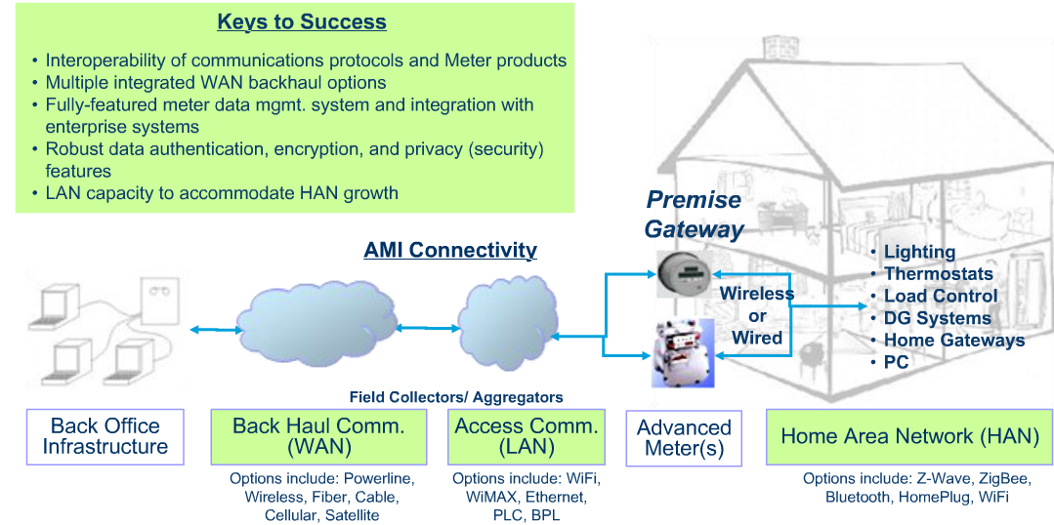

Smart Grid Communication Networks
Source:
Notes:
Smart grid的通信網路
請注意到 Keys to success
請注意到 back haul communication, Access Communication, 及Home Area Network各自的candidate communication technologies

Slide 55
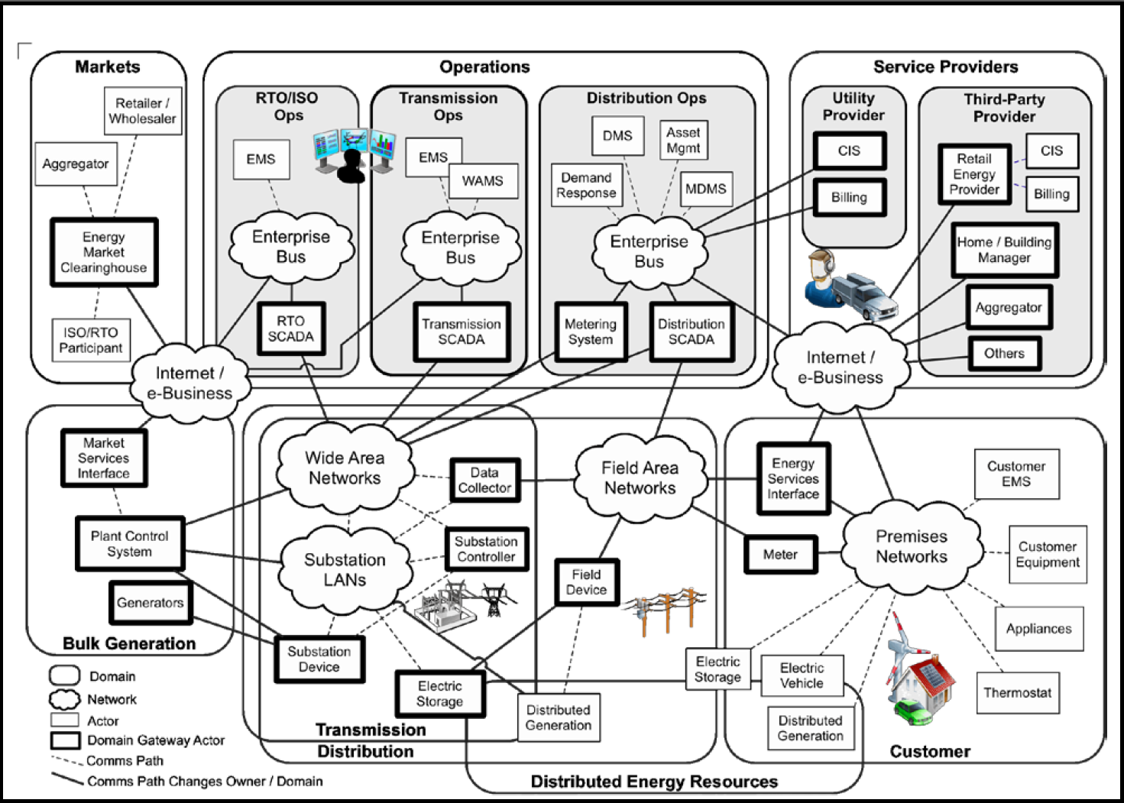
NIST Smart Grid Information Network
MDMS Meter Data Management System
EMS Energy Management System
DMS Distribution Management System
WAMS Wide-Area Measurement System
CIS Customer Information System
Notes:
詳細的smart grid information network示意圖 （有七大方框；對應到先前敘述的七個子系統/雲）
CIS Customer Information System
DMS Distribution Management System
EMS Energy Management System
MDMS Meter Data Management System
WAMS Wide-Area Measurement System

Slide 56
NIST’s Smart Grid Standards
Regulatory Organizations
FERC
Federal Energy Regulatory Commission
Technical Consortia/Forums/Panels
NIST
National Institute of Science and Technology
Marketing/Advocacy Organizations
UCA International Users Group
Smart Grid Interoperability Panel (SGIP)
GridWise Alliance
OpenHAN
OpenADR
Demand Response and Smart Grid Coalition
CIM
IEC 61850
GridWise Architecture Council
HomeGrid Forum
OASIS
HomePlug Alliance
NEMA
SAE International
Standards Development Organizations
IEEE
802.11
802.15
802.16
IEEE PES
P2030
IETF
IEC
ATIS
CEN/CENELEC
WiFi Alliance
ITU
TIA
ZigBee
WiMAX Forum
ISO
ETSI
Notes:
NIST 智能電網的標準架構圖

Slide 57
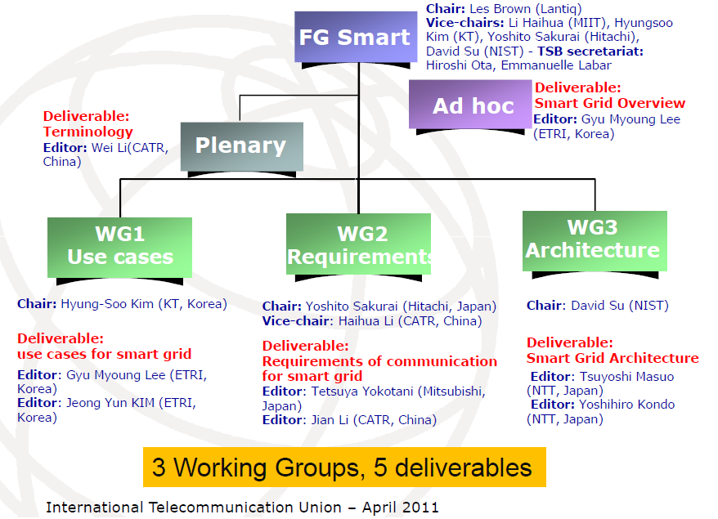

ITU-T’s Smart Grid Focus Group
ITU-T Focus Group on Smart Grid (FG Smart), since 8-11 February 2010 and concluded in the end of 2011.
Notes:
CATIR:工业和信息化部电信研究院
ITU-T Focus Group on Smart Grid (FG Smart), since 8-11 February 2010 and concluded in the end of 2011.

Slide 58

References
NIST Smart Grid, NIST Releases Final Smart Grid 'Framework 2.0' Document; http://www.nist.gov/smartgrid/
IEEE P2030 Smart Grid Series: http://grouper.ieee.org/groups/scc21/dr_shared/2030/
ITU-T Focus Group on Smart Grid (FG Smart) http://www.itu.int/en/ITU-T/focusgroups/smart/Pages/Default.aspx
ETSI M2M Smart Grids http://www.etsi.org/WebSite/Technologies/SmartGrids.aspx
IETF RFC 6272, Internet Protocols for the Smart Grid. June 2011.

Slide 59
Smart Home

Slide 60
Outline
M2M Area Networks: A Variety of Device Types and Protocols
Smart Home Demonstration
Case 1: Home AV Entertainment
Case 2: Home Gateway
Notes:
介紹四個use cases

Slide 61
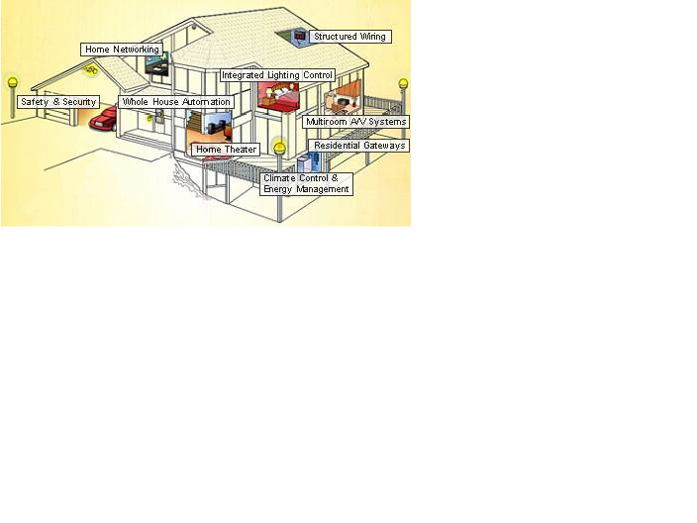
Household Environment
Home Automation
http://www.caba.org/
Notes:
Smart home 的廣義涵蓋範圍（參考下一頁的動畫介紹，逐一說明每一類型的應用）

Slide 62
Structured Wiring
Structured wiring systems offer a planned and organized approach towards low-voltage, residential wiring. Characteristics of structured wiring include that it is permanent and behind walls, accessible through wall outlets, and has planned, flexible and documented topology. Structured wiring is popular because its allows for efficient hook-up of home theaters, home networks and residential gateways. Structured wiring will also “future-proof” homes for changes and additions, which can dramatically increase the resale value of a home.
Multi-room A/V Systems
Multi-room A/V systems provide a seamless A/V environment throughout an entire home, usually via structured wiring. A/V receivers and playback devices such as CD-ROMs, VCRs, DVDs and MP3 jukeboxes can be centralized and integrated into the home’s wiring or wireless systems, while speakers and integrated TV units are located throughout the entire residence. The centralized playback devices can be accessed from multiple rooms, allowing A/V signals to become ubiquitous throughout the home. Multi-room A/V systems can be integrated in home theater systems.
Climate Control & Energy Management
Heating, Ventilation, and Air Conditioning (HVAC) systems can be installed into a home that can be controlled in the home or via telephone or the Internet from anywhere. New climate control systems can allow the homeowner to save energy by dividing the home into specific heating and cooling zones. Climate control can be integrated into whole home automation systems allowing for efficient integrated energy management. Integrated energy management allows homeowners to accurately measure and control their energy consumption through electronic sub-metering and load control.
Residential Gateways
A residential gateway is a singe, intelligent, standardized and flexible network interface unit that receives communication signals from various external networks and delivers the signals to specific consumer devices through in-home networks. A residential gateway usually includes an embedded broadband modem, dynamic routing capacity, security features, and direct or indirect support for home networking.
Whole House Automation
Whole house automation allows users to integrate and control all their communications, lighting, audio/video, heating and cooling and energy management from the Internet, in-home network devices, cell phones and touch screen panels located throughout the home. Whole house automation can allow homeowners to monitor their home via closed-circuit television cameras and to remotely control a myriad of devices, including garage doors.
Home Theater
A home theater is an entertainment system that attempts to recreate the experience of a cinema or concert hall in the home. It is usually composed of audio/video technologies such as digital versatile disk (DVD) and high-definition television (HDTV) that utilize surround sound. Home theaters can range from a base TV and entry-level home theater receiver and speakers to virtual theaters with custom seating, staging and concessions.
Safety and Security
Safety and security systems protect homeowners from fire and intrusion. Such systems utilize alarms, central station monitoring, electronic access control to the home, and even closed circuit television (CCTV). These systems are usually hard-wired into the home’s infrastructure and are monitored constantly by security companies for a fee to protect residences from emergencies and alert relevant authorities.
Integrated Lighting Control
Integrated lighting control systems offer a controlled approach towards illuminating a home, through automatic switching and dimming controls. Integrated lighting can be controlled through a myriad of technology, including structured wiring, wireless, power line and sensor controlled switching.
Home Networking
Home networking allows a homeowner to link multiple computers and peripherals, such as printers, to each other and share a single Internet connection throughout an entire residence. Consumers typically use home networking to share files such images and documents. Home networking can be accomplished over multiple media, including phone line, power line, wireless and through coaxial television cable and Ethernet.
Home Automation
http://www.caba.org/
Notes:
家庭網絡 家庭網絡允許房主連接多個計算機和外圍設備，如印表機，彼此分享貫穿整個居住一個Internet連接。
消費者通常使用家庭網絡共享文件，圖像和文檔。家庭網絡可以實現在多個媒體，包括電話線，電力線，無線和通過同軸電纜電視和乙太網路。

Slide 63
Case I: Home AV Entertainment (with DLNA, UPnP and UPnP AV)
Notes:
Smart Home環境中以DLNA、UPnP及UPnP AV產業標準，實現數位家庭影音娛樂之應用情境
DLNA: digital living network alliance （數位生活網路聯盟）
UPnP: universal plug and play（UPnP Forum）

Slide 64
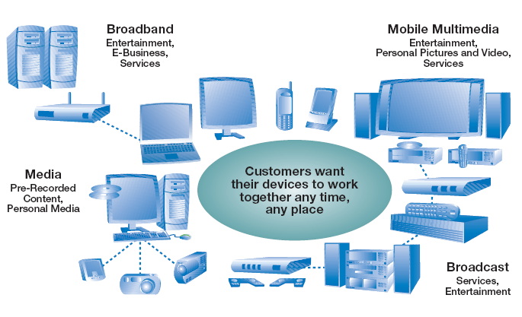
Home AV Entertainment
Notes:
DLNA構思的家庭網路影音娛樂：整合資訊家電、消費性電子產品及行動通訊終端產品，實現家庭網路環境下AV Media Sharing
The OSGi Alliance, formerly known as the Open Services Gateway initiative, is an open standards organization.

Slide 65
Home AV Entertainment
Home networked devices (HNDs)
Mobile, PC, and CE product domains
TV, mobile phone, game console, personal video recorder, IP set-top-box, network attached storage (NAS), desktop, and laptop
Upgraded capabilities: computation, networking, multimedia processing, storage
Standard bodies
Interoperability for distributed multimedia services among PC, CE and mobile devices in home networks
Digital Living Network Alliance (DLNA)
Universal Plug and Play (UPnP) Forum
UPnP networking middleware is to be a uniform device and service discovery framework.
UPnP AV Profile is for AV playback services in UPnP-based networks
Notes:
Home networked devices (HNDs) 包含的產品類型，不同於過去的家電僅具有封閉性的功能，現在高階的HND有有Upgraded capabilities: computation, networking, multimedia processing, storage等資源與能力。
主流的產業規格標準化組織：DLNA及UPnP
DLNA直接建議使用UPnP Forum所提出的UPnP networking middleware 為所有DLNA網路家電的網路協定中介層（各式協定的對照，請參考下一頁投影片）

Slide 66

DLNA and UPnP
DLNA Specification
Functional Components
UPnP Technology Ingredients
UPnP Communication Protocols
Media format
Image, Audio and AV
UPnP AV 1.0 and UPnP Printer:n
UPnP Vendor
Media Mang’t & Control
and
Device Mang’t & Control
UPnP Forum
UPnP Device Architecture
UPnP Device Architecture 1.0
SSDP
SOAP
GENA
HTTP 1.0/1.1 and RTP (Optional)
HTTPU
HTTPMU
HTTP
Media Transport
UDP
TCP
IPv4 Protocol Suite
IP
Network Stack
Ethernet and 802.11 Media
Network Connectivity
Digital Living Network Alliance (DLNA)
Notes:
DLNA 規格 → UPnP 規格之間的對應關係 （DLNA多是網路訊息及媒體格是的相容性規範，interconnection與transport的部分直接採納UPnP Forum所提出的UPnP Communication Protocol stacks ）
SSDP: simple service discovery protocol
SOAP: simple object access protocol
GENA: general event notification architecture
HTTPU is an extension of the HTTP/1.1 protocol using UDP as the data transport instead of the usual TCP protocol.
HTTPMU is a variant of HTTPU that uses IP multicast.
For information about Multicast and Unicast UDP HTTP Messages via http://tools.ietf.org/html/draft-goland-http-udp

Slide 67

UPnP Functionality
An open standard based on the widely known Internet technology.
Leveraging the TCP/IP and Web protocols to enable
Seamless proximity networking,
Control among networked devices, and
Data transfer among networked devices
UPnP is a discovery framework
To enable devices and services to properly discover, configure, and communicate with each other.
To know the availability and capability of peer devices without explicit administration.
To find resources automatically rather than needing pre-configured bindings to specific resources
Notes:
學理上，UPnP技術主要歸類在 Device & Service Discovery Methodology，主要適用在小型區域網路或是ad hoc的網路之間，不適用在WAN
UPnP技術並不是逕自發展出另一套新的網連規格，而是從現有各式網際網路標準化的技術中，彙整出一套適用的網路協定（如上一頁所示），以求network interoperability最大化。

Slide 68
UPnP Functionality (Cont.)
Two UPnP entities
Controlled Device
In the role of server, offering services to be used by CPs.
Control Point (CP)
To monitor or control devices
Six functional layers
5
Presentation
Device and service information with HTML file
4
Eventing
Event notification by GENA message
3
Control
Action invocation by SOAP message
2
Description
Device and service description files with XML templates
1
Discovery
Device and service discovery by SSDP
0
Addressing
Network address assignment by DHCP or Auto-IP
Notes:
UPnP的主要功能包括六個functional layers. (可以由下而上介紹)
0. Addressing is an underlying function enabling a device to acquire a unique network IP address when it newly joins a network. The default addressing method is dynamic host configuration protocol (DHCP), and automatic IP configuration [notes below] is used as the absence of DHCP service.
1. Discovery is the capability for a device to advertise its appearance and services in the network, so a control point can find the device and its information.
2. Description is used for a device to summarize its services and capabilities in a well-defined format, so control points can parse description files and know what a device offers.
3. Control is the capability for a device to handle requests from control points and to invoke specific actions.
4. Eventing is used by a device to notify the registered control points whenever any interested state changes.
5. Presentation is an HTML-based interface provided by device for users to control or monitor them directly.
Auto-IP: 169.254.*.*
A link-local address is an Internet Protocol address that is intended only for communications within the segment of a local network (a link) or a point-to-point connection that a host is connected to. Routers do not forward packets with link-local addresses.
RFC 3927, Dynamic Configuration of IPv4 Link-Local Addresses, S. Cheshire, B. Aboba, E. Guttman, The Internet Society (May 2005).
Microsoft refers to this address auto-configuration method as Automatic Private IP Addressing (APIPA). It is sometimes also casually referred to as auto-IP.

Slide 69

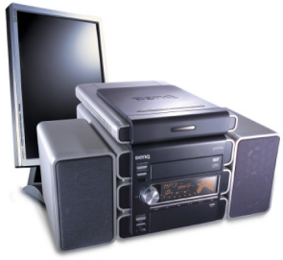
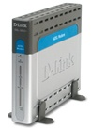
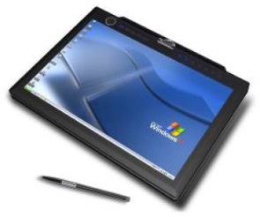
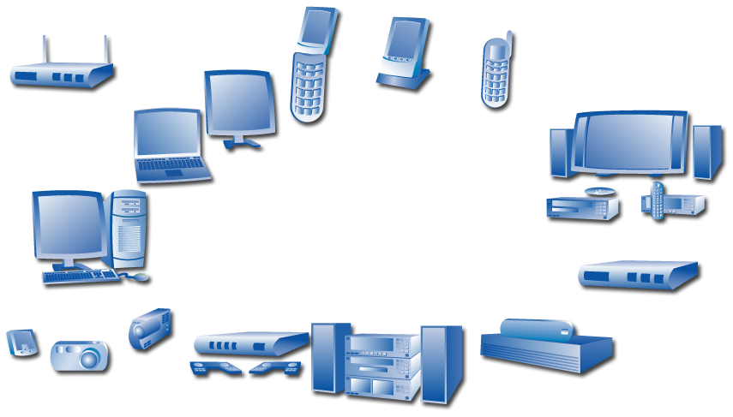
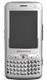
UPnP Logics
Device
PC
4) PC responds subscription-UUID to CP. 4) PC informs CP of GENA events (to notify changes of service states).
192.168.10.1
1) PC device sends SSDP messages for device advertisement onto 239.255.255.250:1900 (a multicasting address).
0) PC get an IP addr. 192.168.10.1 from DHCP server
3) CP sends SOAP actions messages to control PC.
2) PC responds XML descriptions to CP.
AP router
2) CP accesses PC’s device and service descriptions.
0) get an IP addr. 192.168.10.2
1) CP receives PC’s device advertisement from 239.255.255.250:1900.
192.168.10.2
4) CP subscribes to PC’s services.
Ultra-Mobile PC (UMPC)
Control point
Notes:
一個以UPnP方式操控的實施例（以動畫顯示每個步驟）

Slide 70
UPnP Service Profiles: UPnP Device Categories
Audio/Video
MediaServer V2.0 & MediaRenderer V2.0
MediaServer V1.0 & MediaRenderer V1.0
Basic
Basic Device V1.0
Home Automation
Digital Security Camera V1.0
HVAC V1.0
Lighting Controls V1.0
Networking
Internet Gateway V1.0
WLAN Access Point V1.0
Printer
Printer Enhanced V1.0
Printer Basic V1.0
Remoting
Remote UI Client V1.0 & Remote UI Server V1.0
Scanner
Scanner V1.0
Add-on Services
Device Security V1.0 & Security Console V1.0
Quality of Service V1.0
Quality of Service V2.0
Lower Power V1.0
Notes:
UPnP Forum提出的各式service profiles

Slide 71
Case II: Home Gateway
Notes:
Home 閘道器

Slide 72
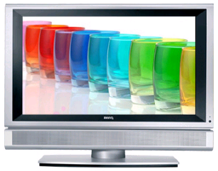
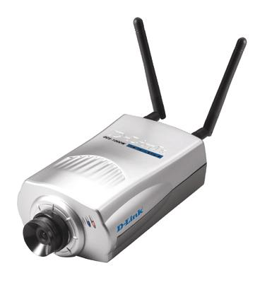
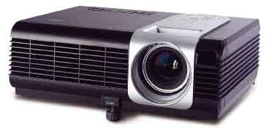
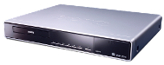
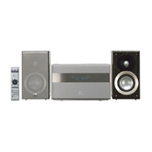

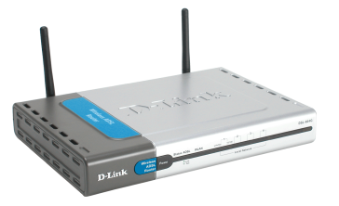
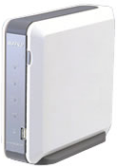









The Role of Home Gateway for Broadband Network Access
Entertainment
Security
Home Gateway
Broadband modem
PC
Internet
Video service
Personal Music Content
Gaming
Notes:
裝置之間存在有很大的異質性，並且不同裝置使用的網路媒介也不盡相同。需要 “Home Gateway家用閘道器”這中間角色才可以實現之間的互連及服務應用。
另外，若要從外部網路連進家裡，操控各式家電，也需要有“家用閘道器”這中間角色才可以實現。
以上說明家用閘道器的重要性

Slide 73
Home Gateway
A device that
offers broadband connectivity to the home,
delivers services to home environments, and to different devices and interfaces that makes up home environments.
Requirements
Providing a remote management service to the home gateway, home networks and the devices beyond the home gateway in the customer environment.
Allowing the right device or application to connect to the right service platform with the right service class (QoS).
Recognizing and potentially uniting device capabilities.
Playing a role in the home network to join device capabilities and offer customers a better “integrated home environment.”
Notes:
家用閘道器的功能需求及定義

Slide 74
Crossover Env. for Services and Standards
Notes:
pp. 23-25 說明有無使用家用閘道器的環境差異

Slide 75

Crossover Env. for Services and Standards
Notes:
服務與標準的交叉環境

Slide 76

Crossover Env. for Services and Standards
Notes:
服務與標準的交叉環境

Slide 77

Notes:
MOTOROLA的展示

Slide 78
Backup Materials - OSGi
Notes:
補充資料
OSGi

Slide 79
Notes:
OSGI 架構圖

Slide 80
OSGi Middleware
Notes:
OSGi 的中介軟體

Slide 81
OSGi Service-Oriented Framework
Addressing a unified software market, …
Limited (binary) software portability problem
Lack of portability causes market friction: no large market of reusable components and applications
Unnecessary constraints on hardware and software architectures
Complexity of building heterogeneous software systems
Supporting the myriad of configuration and customizations required by various devices
A DVD player can contain 1 Million lines of code
A BMW can contain up to 50 networked computerized devices.
An average programmer writes dozens lines of code a day …
Managing software life-cycle on the device
Applications run unmodified on different H/W and S/W architectures.
Notes:
OSGi 服務導向的框架
.解決一個統一的軟體市場
限縮了（二進制）軟體的可移植性問題
缺乏便攜性會導致市場不合：沒有大的市場可重用的組件和應用程序上的硬體和軟體體系結構不必要的限制
構建異構軟件系統的複雜性
不同的裝置需支持大量的組態配置和客制化設定
DVD播放機可以容納1萬行代碼
寶馬最多可包含50個聯網的電腦設備。
一個普通的程序員每天寫代碼數十行...
管理軟件生命週期的設備上
應用程序無需修改即可在不同的H/W和S/W架構正常執行

Slide 82

Service Oriented Architecture
Separate the contract from the implementation
Allows alternate implementations
Dynamically discover and bind available implementations
Based on contract (interface)
Components are reusable
No coupled to implementation details
Notes:
OSGi 服務導向架構
從實作上分離契約
允許替代實施
動態發現並綁定可用的實現
根據合同（接口）
組件是可重複使用
沒有連接到實施細節

Slide 83
Service Oriented Architecture
OSGi Service Registry
Provides an in-VM service model
Discover and get notified about services based on their interface or properties
Bind to one or more service
Many standardized services
Device Management
Standardized API for remote device management
S/W life-cycle does not stop when a networked device leaves the manufactory.
On-line update and new installs are a fact of life
Notes:
OSGi服務註冊
提供了一個虛擬機的服務模式
發現並獲得基於其界面或性質上通知有關服務
綁定到一個或多個服務
許多標準化的服務
設備管理
遠程設備管理標準化的API
當一個網絡設備離開製造廠S/W的生命週期不會停止。
在線更新和新的安裝是生活中的事實

Slide 84

OSGi Service-Oriented Framework
Allows applications to share a single Java VM
Isolation/security
Communication between applications
Collaboration between applications
Life cycle management
Policy free
Policies are provided by bundles
A bundle is comprised of Java classes and other resources which provide functions to end users
A bundle is deployed as a JAR.
APIs are fully self-managed.
Notes:
允許應用程序共享一個單一的Java虛擬機
隔離/安全
應用程序之間的通信
應用程序之間的協作
生命週期管理
Policy 自由
Policy是由bundles提供
bundle是由Java classes和它們提供的功能給最終用戶等資源
一個bundle被部署為JAR
API是完全自我管理。

Slide 85
Smart Cities
Notes:
智慧城市

Slide 86
Outline
Introduction
Smart cities – the need
Smart cities – a working definition
Smart cities – some examples
Roles, actors, engagement
Transport and logistics – an IoT perspective
Conclusion
Notes:
大綱
‧介紹
‧智慧城市 - 需求
‧智慧城市 - 一個工作定義
‧智慧城市 - 一些例子
‧運輸和物流 - 物聯網視角
‧結論

Slide 87

Introduction
It is predicted that 70% of the world’s population will be living in cities by 2050.
Increasing natural resource constraints, marked increases in population, and a restructuring of the global economy.
Cities need to handle massive tensions in environmental impact, economic growth, and social evolution.
As a result, so-called “Smart Cities” have rapidly become a hot topic within technology communities.
Notes:
據預測，到2050年世界人口的70％將生活在城市。
增加自然資源限制，人口顯著增加，以及全球經濟結構調整。
城市需要處理環境影響，經濟增長和社會進化方面的巨大緊張。
因此，所謂的“智能城市”迅速成為技術社區的熱門話題。

Slide 88

Smart cities – the need
Cities now account for 75% of the world’s greenhouse emissions, but take only 2% of the earth’s surface area. As the same time, the size and economic outputs of cities is on par with small nations.
Cities need to provide for the majority of the world’s citizens while rapidly decreasing environmental impact. As the result, the need for smart cities is discussed in a variety of settings, including the need for climate change mitigation.
Notes:
城市目前佔世界溫室氣體排放的75％，但只佔地球表面積的2％。 同時，城市的規模和經濟產出與小國相當。
城市需要為世界上大多數公民提供，同時迅速減少對環境的影響。 因此，在各種環境中討論了對智能城市的需求，包括減緩氣候變化的需要。

Slide 89
Smart cities – the need
Technical innovation has the opportunity to provide some of the solutions to the era of urbanization, thus helping to both reduce environmental impact and also create new jobs and promote growth and citizen engagement.
Information and Communications Technology (ICT) can be applied in the built environment to help solve issues such as traffic congestion, energy consumption, and behavioral change.
Notes:
技術創新有機會為城市化時代提供一些解決方案，從而幫助減少對環境的影響，並創造新的就業機會，促進增長和公民參與。
信息和通信技術（ICT）可以應用在建築環境中，以幫助解決交通擁堵，能源消耗和行為變化等問題。

Slide 90
Smart cities – a working definition
We define a smart city as one that uses data and ICT in order to :
Manage and optimize existing infrastructure investments
More efficient, new, or enhanced services
Climate change mitigation
Innovative business models
Notes:
我們將智慧城市定義為使用數據和ICT的城市，以便：
管理和優化現有基礎設施投資
更高效，新穎或增強的服務
氣候變化緩解
創新的商業模式

Slide 91

Smart cities some examples
Smart Transportation
Solutions for parking traffic monitoring, public transport management
Smart Healthcare
Electronic records, hospital asset, remote monitoring management
Smart Education
eLearning, MOOCs, and connected campuses
Security and Public Safety
Video surveillance, and workflows for emergency services
Smart Buildings
Smart meters, light, heating, and water and waste management
Notes:
智能交通-停車交通監控，公共交通管理解決方案

Slide 92

Smart cities some examples
Smart Transportation
Solutions for parking traffic monitoring, public transport management
Smart Healthcare
Electronic records, hospital asset, remote monitoring management
Smart Education
eLearning, MOOCs, and connected campuses
Security and Public Safety
Video surveillance, and workflows for emergency services
Smart Buildings
Smart meters, light, heating, and water and waste management
Notes:
智能醫療-電子記錄，醫院資產，遠程監控管理

Slide 93

Smart cities some examples
Smart Transportation
Solutions for parking traffic monitoring, public transport management
Smart Healthcare
Electronic records, hospital asset, remote monitoring management
Smart Education
eLearning, MOOCs, and connected campuses
Security and Public Safety
Video surveillance, and workflows for emergency services
Smart Buildings
Smart meters, light, heating, and water and waste management
Notes:
智能教育-電子學習，MOOCs和連接的校園

Slide 94

Smart cities some examples
Smart Transportation
Solutions for parking traffic monitoring, public transport management
Smart Healthcare
Electronic records, hospital asset, remote monitoring management
Smart Education
eLearning, MOOCs, and connected campuses
Security and Public Safety
Video surveillance, and workflows for emergency services
Smart Buildings
Smart meters, light, heating, and water and waste management
Notes:
安全和公共安全-影音監控和緊急服務的工作流程

Slide 95

Smart cities some examples
Smart Transportation
Solutions for parking traffic monitoring, public transport management
Smart Healthcare
Electronic records, hospital asset, remote monitoring management
Smart Education
eLearning, MOOCs, and connected campuses
Security and Public Safety
Video surveillance, and workflows for emergency services
Smart Buildings
Smart meters, light, heating, and water and waste management
Notes:
智能建築-智能儀表，光，供暖，水和廢物管理

Slide 96
Roles, actors, engagement (1)
People are both key barriers and key opportunities for change within a smart city use case.
A parent who needs to interact with schools in the district.
An employee who needs to access city infrastructure to get to work.
In addition to the complexity of the number of roles that a citizen plays within a city context, the infrastructure itself is deeply embedded in a number of places.
Notes:
在智能城市用例中，人們是變革的關鍵障礙和關鍵機遇。
-需要與區內學校互動的家長。
-需要訪問城市基礎設施才能上班的員工。
除了公民在城市環境中扮演的角色的數量的複雜性之外，基礎設施本身也深深嵌入在許多地方。

Slide 97
Roles, actors, engagement (2)
A city cannot, in today’s world, survive without its hinterland – the surrounding spaces and other towns and cities that help deliver the natural resources and other services that it uses.
Effective management of multiple interacting logistics issues
Bringing food and water into a city, removing waste.
Delivering the goods and services in and out of the city.
Notes:
一個城市不能在今天的世界裡沒有它的腹地 - 周圍的空間和其他城鎮，幫助提供自然資源和其他服務使用。
有效管理多個相互作用的物流問題
-將食物和水帶入城市，消除浪費。
-提供進出城市的貨物和服務。

Slide 98

Transport and Logistics – an IoT Perspective (1)
How to make decisions about when and where to implement transport infrastructure ?
Manufactures build and sell Infrastructure assets (e.g. trains).
Infrastructure Managers buy Infrastructure from manufacturers, manage and maintain Infrastructure.
Operators run the actual services on the Infrastructure.
Maintainers are responsible for the day-to-day running of different Transport Infrastructure.
End Users use the services.
Regulators provide regulations that companies need to abide by in a variety of situations.
Source: Book by Jan Holler, Catherine H. Mulligan, Stamatis Karnouskos, Vlasios Tsiatsis, David Boyle, Stefan Avesand, “From Machine-to-Machine to the Internet of Things: Introduction to a New Age of Intelligence” .
Notes:
如何決定何時何地實施運輸基礎設施？
製造和銷售基礎設施資產（例如火車）。
基礎設施經理從製造商那裡購買基礎設施，管理和維護基礎設施。
運營商在基礎架構上運行實際服務。
維護人員負責不同運輸基礎設施的日常運行。
最終用戶使用服務。
監管機構提供了公司需要在各種情況下遵守的法規。

Slide 99
Transport and Logistics – an IoT Perspective (2)
However, the sharing of information from M2M systems needs to be expanded within the city context beyond just cars, and needs to instead provide an integrated transport solution that brings together all the actors involved.
Transport is ripe for an IoT solution for several reasons:
Users often know more about the real-time performance of the transport infrastructure than operators and maintainers
Sensors on assets, in combination with data from other actors, provide an increased understanding of infrastructure status, maintenance, and product development needs.
Notes:
然而，來自M2M系統的信息共享需要在城市範圍內擴展，而不僅僅是汽車，而需要提供一個集成的所有參與者的集成運輸解決方案。
物聯網解決方案的運輸已經成熟，原因如下：
-用戶通常比運營商和維護者更了解運輸基礎設施的實時性能
-資產傳感器結合來自其他參與者的數據，提高了對基礎設施狀態，維護和產品開發需求的理解。

Slide 100

Information Marketplace for Transport and Logistics (1)
Source: Book by Jan Holler, Catherine H. Mulligan, Stamatis Karnouskos, Vlasios Tsiatsis, David Boyle, Stefan Avesand, “From Machine-to-Machine to the Internet of Things: Introduction to a New Age of Intelligence” .
Notes:
The author break the IoT solution up into several parts of a value chain:

Slide 101
Information Marketplace for Transport and Logistics (2)
Source: Book by Jan Holler, Catherine H. Mulligan, Stamatis Karnouskos, Vlasios Tsiatsis, David Boyle, Stefan Avesand, “From Machine-to-Machine to the Internet of Things: Introduction to a New Age of Intelligence” .
Notes:
We focus on how they connect together to provide a unified information value chain.

Slide 102
The devices and sensors here provide
information about the following:
map
timetable
Source: Book by Jan Holler, Catherine H. Mulligan, Stamatis Karnouskos, Vlasios Tsiatsis, David Boyle, Stefan Avesand, “From Machine-to-Machine to the Internet of Things: Introduction to a New Age of Intelligence” .
Notes:
… Operation/ Business support system: within a transport scenario, they may be used to measure how many people walk between different modes of transport. (between bus to train)

Slide 103
During the processing stage,
data from various sources is mixed together.
Source: Book by Jan Holler, Catherine H. Mulligan, Stamatis Karnouskos, Vlasios Tsiatsis, David Boyle, Stefan Avesand, “From Machine-to-Machine to the Internet of Things: Introduction to a New Age of Intelligence” .
Notes:
… These data sources are combined together to create insight and information necessary for transport decision-making.
e.g.: Understanding how to best deliver public transport services to lower-income communities.

Slide 104
It creates components which could be produced as charts,
or other communicating information to end users.
Source: Book by Jan Holler, Catherine H. Mulligan, Stamatis Karnouskos, Vlasios Tsiatsis, David Boyle, Stefan Avesand, “From Machine-to-Machine to the Internet of Things: Introduction to a New Age of Intelligence” .
Notes:
… Difficulty is everyone from urban planners to transport professionals will need to view and understand the data quickly in order to make decisions.

Slide 105
For improving internal decision-making.
For resale to other economic actors.
Source: Book by Jan Holler, Catherine H. Mulligan, Stamatis Karnouskos, Vlasios Tsiatsis, David Boyle, Stefan Avesand, “From Machine-to-Machine to the Internet of Things: Introduction to a New Age of Intelligence” .
Notes:
There are two main categories that these information products fall into: …

Slide 106
Conclusions
The role of IoT in cities is one that will only increase as the pressure on cities to deliver services at reduced costs for an expanding population increases.
Due to the complexity in cities, the best way for them to achieve the desired outcomes of smart cities is to utilize an information marketplace approach.
Notes:
物聯網在城市中的作用只會隨著城市對人口不斷增加而以降低成本提供服務的壓力而增加。
由於城市的複雜性，他們實現智能城市所期望的結果的最佳方式是利用信息市場方法。

Slide 107
Connected Car

Slide 108
Outline
GM OnStar
Ford SYNC
GM OnStar versus Ford SYNC
Notes:
大綱
‧GM OnStar
‧Ford SYNC
‧NCTU SPC-Cloud

Slide 109

Onstar

Slide 110

OnStar
Since beginning operations in 1995, General Motors' OnStar system has grown to become the nation's leading provider of in-vehicle safety, security and communications services using wireless and Global Positioning System (GPS) satellite technology.
OnStar is available on more than fifty 2009 and newer GM models. There are already 6 million OnStar subscribers in the U.S. and Canada in July 2012.
Notes:
OnStar系統通過無線網路和GPS的技術提供了車輛行車安全，安全和通訊等服務。

Slide 111

Technical
the service relies on CDMA mobile phone voice and data communication, as well as location information using GPS technology
In the event of a collision, detected by airbag deployment or other sensors, it can automatically send information about the vehicle's condition
and GPS location to
OnStar call centers
Notes:
OnStar提供的服務都是依靠CDMA行動電話進行聲音和資料的傳輸，也可以用GPS定位后傳輸位置資訊。
在遇到車禍的時候，airbag或其他sensor會偵測到有碰撞，OnStar的系統會自動的送出有車輛目前狀況(包括GPS位置)資訊給OnStar的call centers，以便可以進行救援或給予何協助。

Slide 112
Advanced Automatic Crash Notification System(AACN)
Starts recording in the event of a crash , like an airplane’s black box.
Comprises four components: sensors, the Sensing Diagnostic Module, the Vehicle Communication and Interface Module(VCIM) and the cellular antenna
When the car is in a crash, sensors transmit information to the Sensing Diagnostic Module(SDM)
SDM includes an accelerometer, which measures the severity of the crash based on gravitational force
Notes:
AACN(高级自动撞车通报系统 )就像是飛機上的黑箱一樣，只不過它只會在車輛發生相撞的時候開始記錄。
AACN系統由四部份組成：感測器、感測診斷模組、VCIM(接口模塊)和蜂窩天線。
當車輛發生碰撞的時候，感測器會將資訊傳送給感測診斷模塊(SDM)。
感測診斷模塊(SDM)包含了加速度計，可以用來量測車輛否發生碰撞。

Slide 113




1
2
3
4
Notes:
碰撞資訊被傳給SDM，SDM會判斷碰撞的嚴重性。
SDM把碰撞資訊傳給OnStar模組
在幾秒內，OnStar模組會用蜂窩天線送message給call center
OnStar的接線員會接起由受難車輛發出的call

Slide 114







4. The OnStar switch sends the call to the first available advisor, who has the location of the vehicle and the customer’s information on her computer screen.
2. When the driver pushes the blue OnStar button or red Emergency button, or an air bag deploys, OnStar places a embedded cellular call to the OnStar Center, Vehicle and GPS location data is sent at the beginning of the call.
3. The cellular call is received by a cellular tower and routed to the land line phone system.
1. A GPS receiver in the vehicle picks up signals from Global Positioning System (GPS) satellites and calculates the location of the vehicle. That location information is stored in the vehicle’s OnStar hardware
Notes:
車上的GPS接收器會從全球定位系統(GPS) 衛星上獲得信號並計算出位置信息，儲存在車輛的OnStar硬件上。
當駕駛員按下藍色OnStar按鈕或紅色Emergency按鈕時，或者在氣囊打開時，OnStar會將內置的蜂窩呼叫發到OnStar中心。呼叫一開始，就會發送車輛和GPS定位數據。
蜂窩交換塔會受到蜂窩式呼叫，并路由到電話系統中。
交換器將呼叫轉發到第一個有空的顧問處，他的計算機屏幕上會顯示車輛的位置和自定義信息。

Slide 115





Features
Emergency Services
Security Services
Navigation
Connections
Diagnostics
Notes:
功能
緊急服務
安全服務
導航
連線
診斷

Slide 116
Emergency Services
Automatic Crash Response
In a crash, built-in sensors can automatically alert an OnStar Advisor who is immediately connected into the vehicle to see if driver or passengers need help sent to their exact location — even if they can't say a word.
Crisis Assist
During severe weather and other natural disasters, an OnStar Advisor can help the users navigate their way to safety and provide a reliable connection to loved ones.
Notes:
緊急服務
自動碰撞回應
在車輛發生碰撞的時候，內置的感測器會自動發出警示給OnStar的顧問，然後顧問就會馬上連線到發生車禍的車輛，看車上的司機或乘客需不需要給予幫助，即使他們不能說話，顧問也可以知道他們的所在位置。
危機協助
在天氣很惡劣或者發生天災的時候，OnStar的顧問可以給予駕駛員導航的諮詢。

Slide 117
Security Services
Stolen Vehicle Assistance
OnStar can use GPS technology to pinpoint the stolen car’s exact location
Remote Ignition Block: prevent the stolen vehicle from being restarted once the engine has been turned off.
Stolen Vehicle Slowdown: gradually slow down the stolen vehicle to an idle speed
Remote Door Unlock
Roadside Assistance
Remote Horn and Lights
If can’t locate the vehicle, OnStar advisor will sending a remote signal that triggers its horn and flash its lights
Notes:
安全服務
被盜車輛援助
OnStar可以用GPS的技術來指出被盜車輛的確切位置，也可以將被盜車輛的引擎鎖住和將被盜車輛的車速減慢。
遠端車門解鎖
路邊援助
遠端鳴笛和開燈
如果車輛的車主找不到自己的車子，可以叫OnStar的顧問發送信號給他的車子，叫車子鳴笛或者亮燈，這樣就可以找到他的車子了

Slide 118
Navigation
Turn-by-Turn Navigation
push the OnStar button and tell the Advisor where you want to go, and turn-by-turn directions are downloaded to your vehicle.
Notes:
導航
路線規劃導航
只要按OnStar的按鈕，然後告訴OnStar的顧問說你要去哪裡，路線規劃的方向導航就會下載到你的車上。

Slide 119
Connections
Hands-Free Calling
Wireless services built into OnStar-equipped vehicle, for use when call phone is out of reach, out of range or battery low
OnStar RemoteLink^{(TM)} Mobile App
Check fuel level, oil life and tire pressure from cell phone
Start car or unlock the doors from anywhere
Notes:
連線
免手提撥電話
有裝OnStar的車輛就會有無線服務，當使用者的手機沒電了或者沒信號就可以用OnStar來撥打電話
OnStar遠端連線手機app
可以用手機來檢查油耗，胎壓等，也可以用手機來啟動車輛的引擎或者鎖門

Slide 120
Diagnostics
OnStar Vehicle Diagnostics
vehicle can run hundreds of diagnostic checks on engine, transmission, anti-lock brakes and more
automatically send driver an easy-to-read email summary, giving the confidence to vehicle
Low Mileage Discount
If drive less than 15,000 miles a year, OnStar offer a discount from their cooperative insurance companies
Notes:
診斷
OnStar車輛診斷
可以對引擎，刹車等進行診斷，并將結果用email傳給司機
低里程數折扣
OnStar對低里程數的司機給予他們合作的保險公司的折扣

Slide 121

Ford sync

Slide 122

Ford SYNC
Developed with Microsoft, is an advanced software platform that provides consumers the convenience and flexibility to bring digital media players and Bluetooth-enabled mobile phones into their vehicles and operate the devices via voice commands or with steering wheel’s redundant radio controls.
In Nov. 2012, Ford announced SYNC had been installed in 5 million cars.
Notes:
Ford SYNC是和微軟合作開發出來的，它可以講駕駛員的手機和Ford SYNC用藍牙來同步或者說進行通訊，令駕駛員可以用語音來對Ford SYNC進行指令操作

Slide 123






Technology
Ford uses Microsoft software to read information from user’s smartphone while he/she is driving.
Sync uses user’s phone’s wireless to connect with outside.
With Sync, the user are in the middle of an in-car web of communication between he/she, his/her cell phone and his/her Ford Sync head-unit via Bluetooth
Notes:
當使用者在開車的時候，Ford用微軟的軟體來從他的智慧型手機讀資訊
SYNC用使用者手機上的無線來和外界聯繫
使用者可以透過語音來控制SYNC，操作手機，而SYNC和使用者手機之間是用藍牙來通訊，這三者間在車內形成一個小網路

Slide 124

How SYNC Emergency Assistance Works
Notes:
1. Airbag彈出來或油泵壞掉
2. 初始化緊急救援功能
3. SYNC用GPS和手機上的資料來指出車輛的位置
4. SYNC用使用者熟悉的語言給予使用者提示並且進入緊急外撥過程
5. 在外撥緊急電話前會倒數
6. 電話和座標會直接被送到本地的救援中心
7. 預先錄製好的信息會被傳送到救援中心
8. SYNC會將麥克風打開，讓車輛內的人可以和救援中心的人進行溝通

Slide 125

SYNC Features
Voice-activated, hands-free calling
911 Assist
Voice-activated music
Advanced calling features
Audible text messages
Ring tone support
Multilingual intelligence
Automatic phonebook transfer
Vehicle Health Report (VHR)
Uninterrupted connections
Notes:
SYNC 的特色

Slide 126
Features(1/4)
Voice-activated, hands-free calling
Press the “Push to Talk” button on the steering wheel, and then say the name of the person that user wish to call. SYNC automatically will connect with the names in the mobile phone’s contact list.
Advanced calling features
SYNC includes the same features offered on mobile phones, including caller ID, call waiting, conference calling, a caller log, contact list, signal strength icon, and a phone battery charge icon – all conveniently located on the radio’s display screen.
Notes:
語音激活，免提撥電話
按下方向盤上的“push to talk”按鈕然後說出你要撥電話的對象的名字，SYNC會自動從你行動電話通訊錄上的名字做連結
實現撥電話功能
SYNC有和行動電話一樣的功能，包括呼叫等待，會議撥電話，通訊錄，訊號強度標誌燈，這些都可以在車輛上SYNC的螢幕上顯示

Slide 127
Features(2/4)
Audible text messages
When paired to capable Bluetooth-enabled phone, SYNC will convert text messages from your phone to audio and read them out loud. User can choose to reply from any of 20 predefined responses.
Multilingual intelligence
SYNC is fluent in English, French and Spanish
Vehicle Health Report
To create a health report, SYNC will gather relevant information from the major vehicle control modules and send it to Ford via the customer’s mobile phone. The information automatically is analyzed by Ford, a report is created and notification is sent via text message or e-mail, based on customer preference
Notes:
口語信息
SYNC可以將你行動電話上的信息用語音念出來
多語言智慧
SYNC懂得英文，法文和西班牙文
車輛健康報告
SYNC會將車輛相關資訊收集起來，進行分析，然後再通過email將分析結果等送給使用者

Slide 128
Features(3/4)
911 Assist
When a phone is properly paired, turned on and connected to SYNC- which is designed to happen every time the driver enters the vehicle with his or her cell phone – the system will be ready to assist in placing a call directly to a local 911 emergency operator should an air bag-deploying accident occur
Voice-activated music
SYNC’s advanced voice recognition technology means when you are ready to use your phone or digital music player, just speak simple voice commands
Notes:
911援助
當電話和SYNC已經配對好後，系統就可以在發生緊急事故的時候隨時打電話給911
語音啟動音樂
當你想要聽手機或者SYNC上的音樂，只要說出指定的指令就可以了

Slide 129
Features(4/4)
Ring tone support
SYNC will play personal ring tones for supported phones. If you have configured unique ring tones to identify specific callers, SYNC automatically will play those, too.
Automatic phonebook transfer
SYNC automatically and wirelessly will transfer all the names and numbers in a mobile phonebook
Uninterrupted connections
No need to hang up in the middle of a cell phone call as you enter your vehicle. Simple touch the Telephone Button on the steering wheel, and SYNC instantly will connect to a Bluetooth phone.
Notes:
鈴聲支持
SYNC支持個人鈴聲，不同的人可以設置不同的來電鈴聲
自動傳送通訊錄
SYNC可以用無線自動將行動電話上的通訊錄傳到SYNC上
防打斷連線
當你在講電話講一半然後要開車的時候不需要將電話掛斷，只要按方向盤上的電話按鈕，SYNC就可以自動連線到藍牙電話

Slide 130
GM OnStar versus Ford SYNC
OnStar has a phone built-in to user’s vehicle so user can leave his/her cell phone at home; Sync is a voice-activated bridge between user and user’s smartphone while driving
OnStar gives customers live support with navigation and emergency assistance while with Ford the only thing standing-by is Sync software
OnStar system comes with built-in GPS capability so in the event of a crash, operators at GM are notified and already know user’s exact location. But Sync relies on user’s cell phone, if it doesn’t have GPS capabilities, the user can only depend on 911 to triangulate the location.
Notes:
OnStar在使用者的車內有內置的電話，所以使用者可以將他的手機留在家裡，但在SYNC的話使用者的手機扮演著使用者和SYNC溝通橋樑的角色
OnStar給予消費者的服務是可靠並且很直接的，而SYNC給的只是軟體給予的援助
OnStar系統有內置的GPS定位能力，所以在發生車禍的時候外界就已經知道使用者確切的位置，但SYNC得到的GPS位置靠的卻是使用者的手機

Slide 131
Summary
Six key IoT/M2M applications are covered in this unit. Major issues exist on each application.
Industrial Automation: Integration of OT (Operation Technology) and IT (Information Technology). Will require cross disciplinary collaboration and expertise.
Smart Grid: Huge investment required to upgrade the existing power grid. However, will be revolutionary in terms of energy management.
eHealth: Liability issues. However, increasingly important due to aging population.
Smart Home: Lack of a unified standard for all home applications. Nevertheless, one of the most promising applications in the near term.
Smart City: There are multiple roles, actors and engagement thus it involves very large scope and complexity.
Connected Car: GM and FORD have achieved good success. However, more applications are required to create momentum.
Notes:
四個關鍵的IoT/M2M應用。問題存在於每一個應用。
電子衛生保健：責任問題。然而，因為人口老齡化，越來越重要。
智能電網: 需要巨額投資，以提高現有電網。然而，在能源管理方面將是革命性的。
智能家居：缺乏一個所有的家庭應用的統一標準，。然而，在短期內的最有前途的應用之一。
網連汽車：通用和福特汽車公司已經取得了良好的成效。然而，需要越多的應用。

